Slide 1
SINSIN
A Radio Localization Method
August 2023
Agenda
The Technology
Operational Benefits
Present Implementation
This project has received funding from the European Union’s
Horizon 2020 research innovation programme,
administered by EUSPA under grant No. 776253

Slide 2
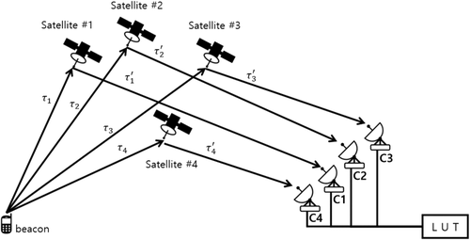
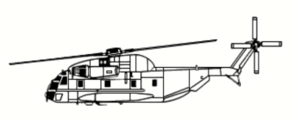
SINSIN Scope
SINSIN is a technology for independent (of GNSS) localization of remote radio beacons
Enhancing C/S MEOSAR
Enabling line of sight localization without satellites
Supporting FGB/ SGB; agnostic to transmission frequency, modulation
Implemented in s/w at the beacon and receiver
Compatible with C/S standards
L-band
S-band
406MHz
SINSIN inside
SINSIN inside
SINSIN inside

Slide 3
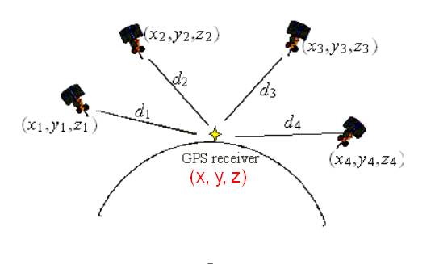
SINSIN Operation Principle
Navigation (GNSS) equations
C*(TOA_{i}–TOE) = √[(x-x_{i})² + (y-y_{i})² + (z-z_{i})²] unknown: receiver (x, y, z), rx clock drift
Localization (C/S) equations
C*(TOA_{i}–TOE) = √[(x-x_{i})² + (y-y_{i})² + (z-z_{i})²]
unknown: beacon (x, y, z), TOE
(x, y. z)
SINSIN
The beacon sets TOE such that the receiver could guess,
enabling TOA based localization with less satellites in view, even directly

Slide 4
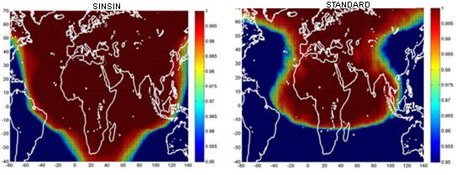
SINSIN Operational Benefits (1)
Geographical coverage
Calculated and Illustrated by Thales Alenia Space
3 satellites
coverage
4 satellites
coverage

Slide 5
SINSIN Operational Benefits (2)
Accuracy
/ Search Time
Calculated by Thales Alenia Space
SGB | 10 min, 95% |  | 20 min, 95% |  | 30 min, 95%
 | standard | SINSIN | standard | SINSIN | standard | SINSIN
3 sats | 1500m | 980m | 1390m | 630m | 1250m | 560m
4 sats | 520m | 430m | 430m | 300m | 280m | 150m

Slide 6
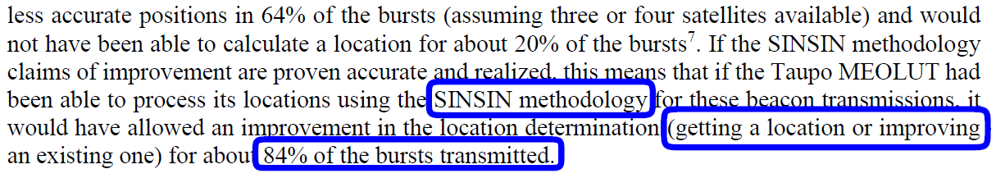
SINSIN Operational Benefits (3)
Availability
Tested and Reported by C/S Secretariat

Slide 7
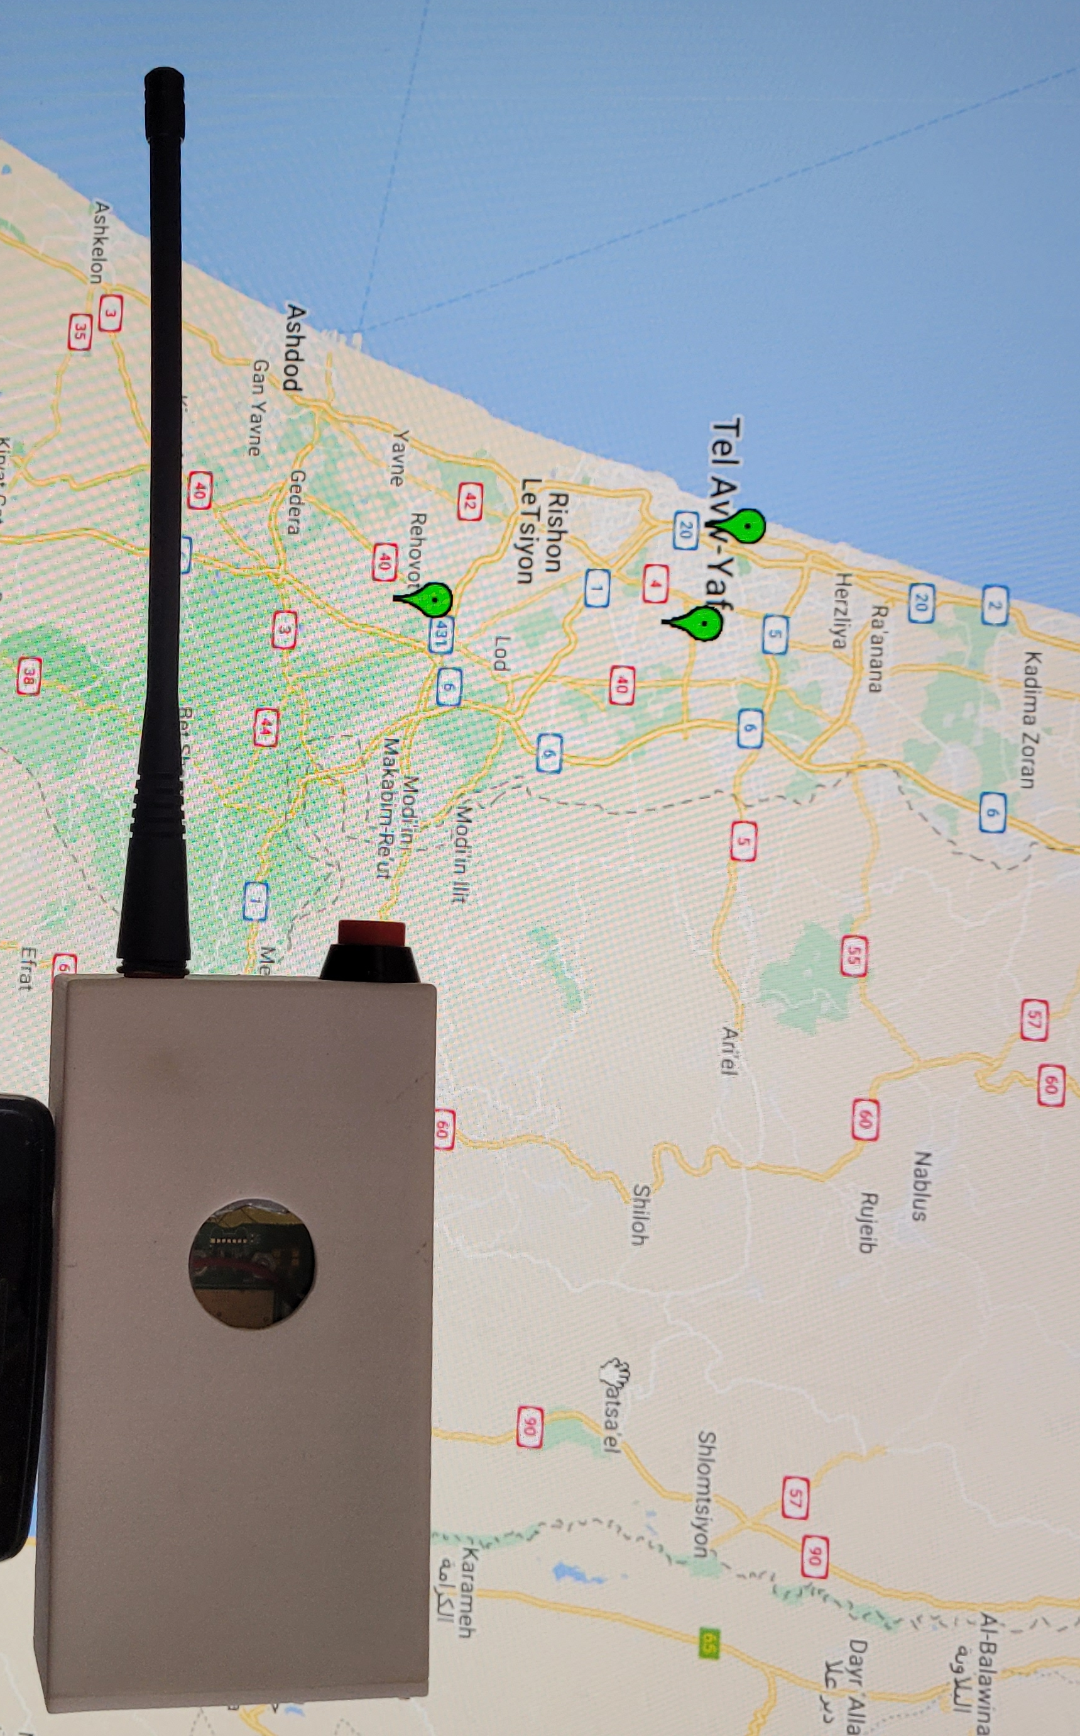

SINSIN Operational Benefits (4)
Direct line-of-sight localization
406MHz
Radio beacon
SINSIN inside
406MHz receiver
SINSIN inside

Slide 8
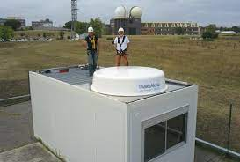
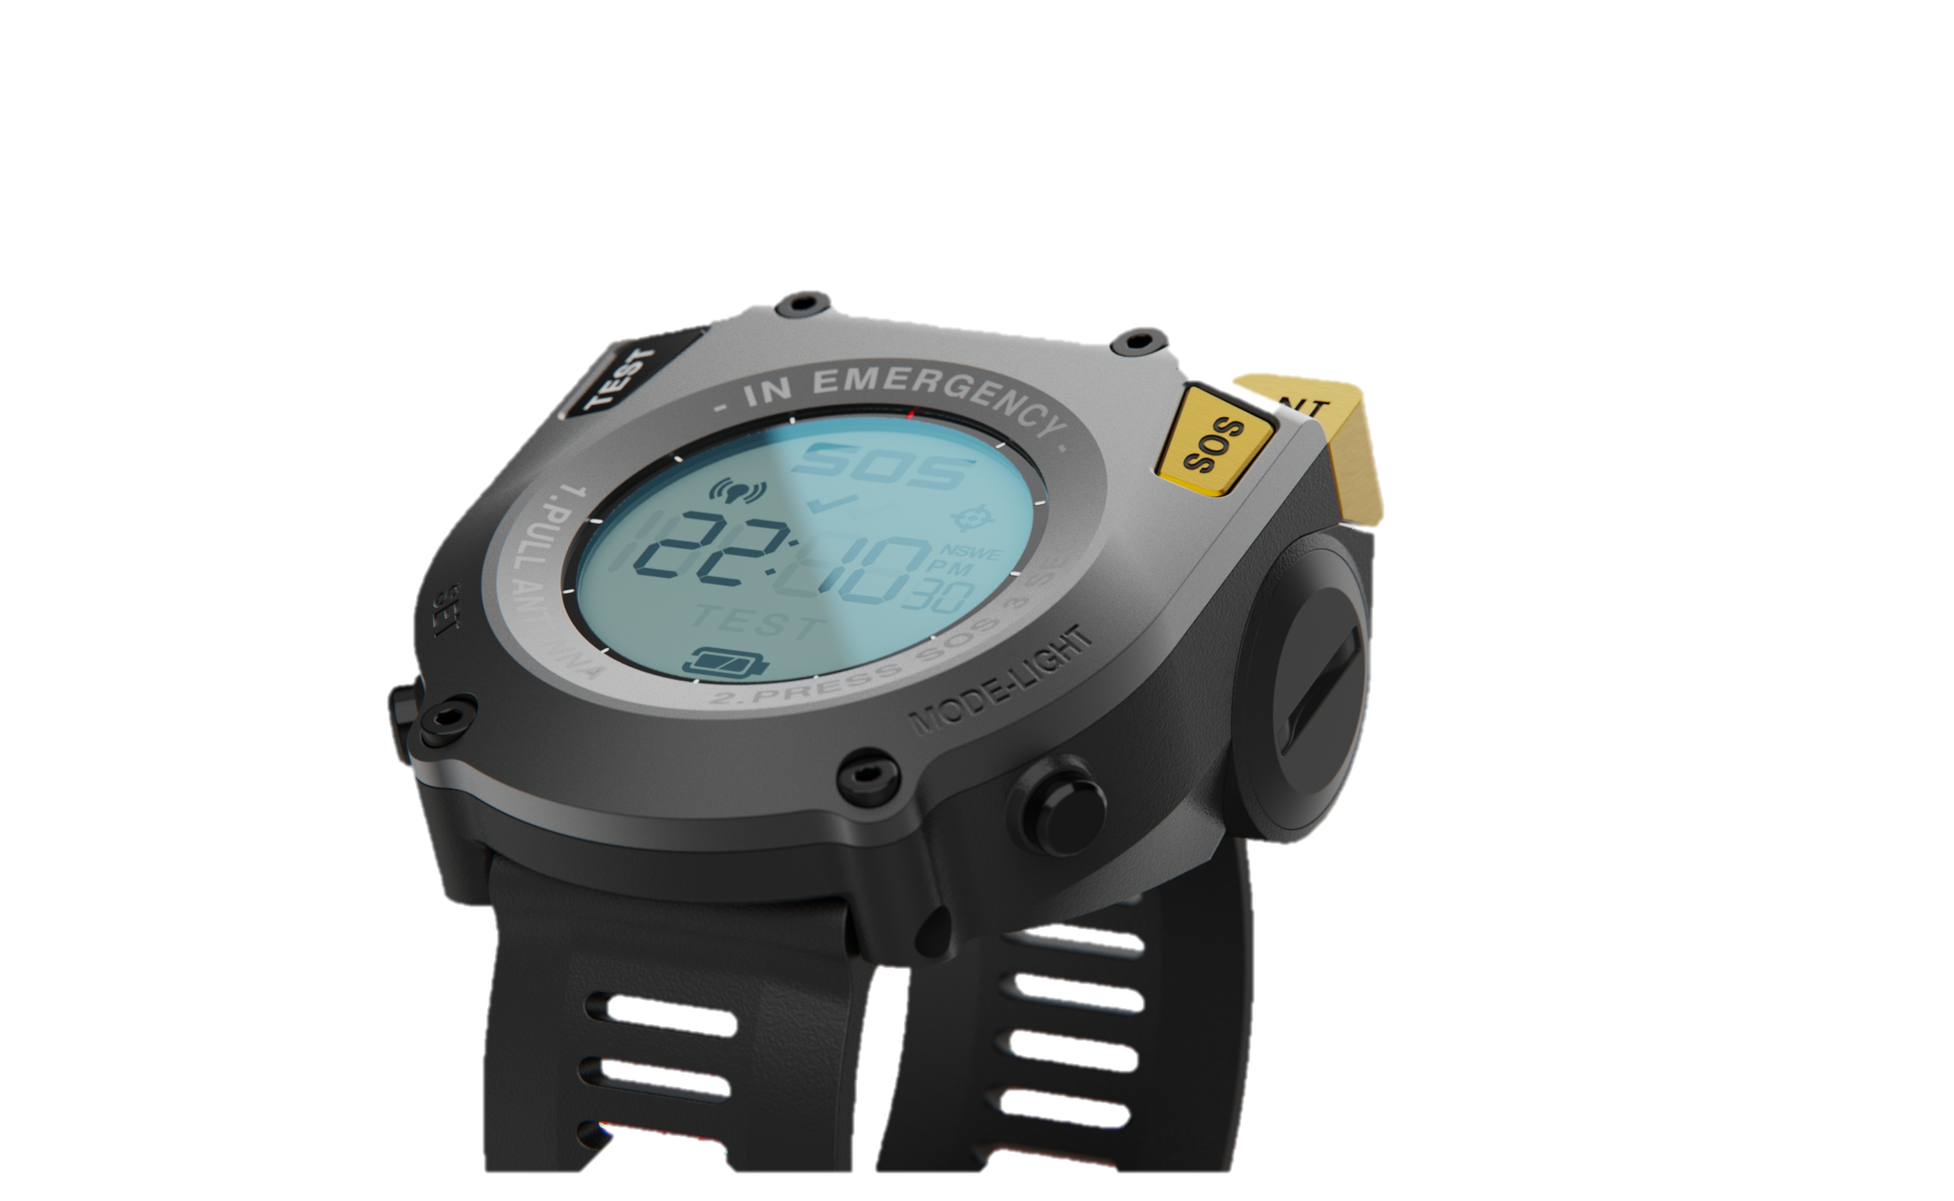
SINSIN Implementation in MEOSAR
SINSIN inside
x2 accuracy
on average

Slide 9
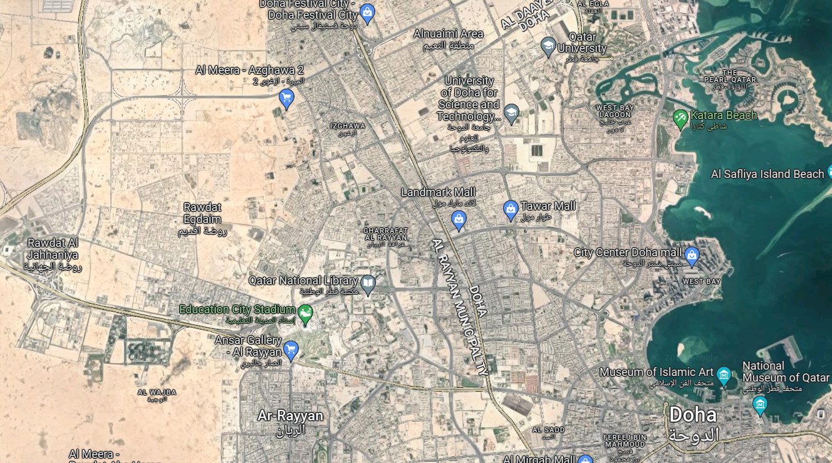
SINSIN Verification
Demonstrated at C/S conference in Qatar, 2019
  Beacon in Doha, MEOLUT in Toulouse
  Relayed by Galileo satellites
< 5,000Km <
reporting
FGB
3 sats standard
2 sats standard
Real Location
3 sats SINSIN
2 sats SINSIN

Slide 10
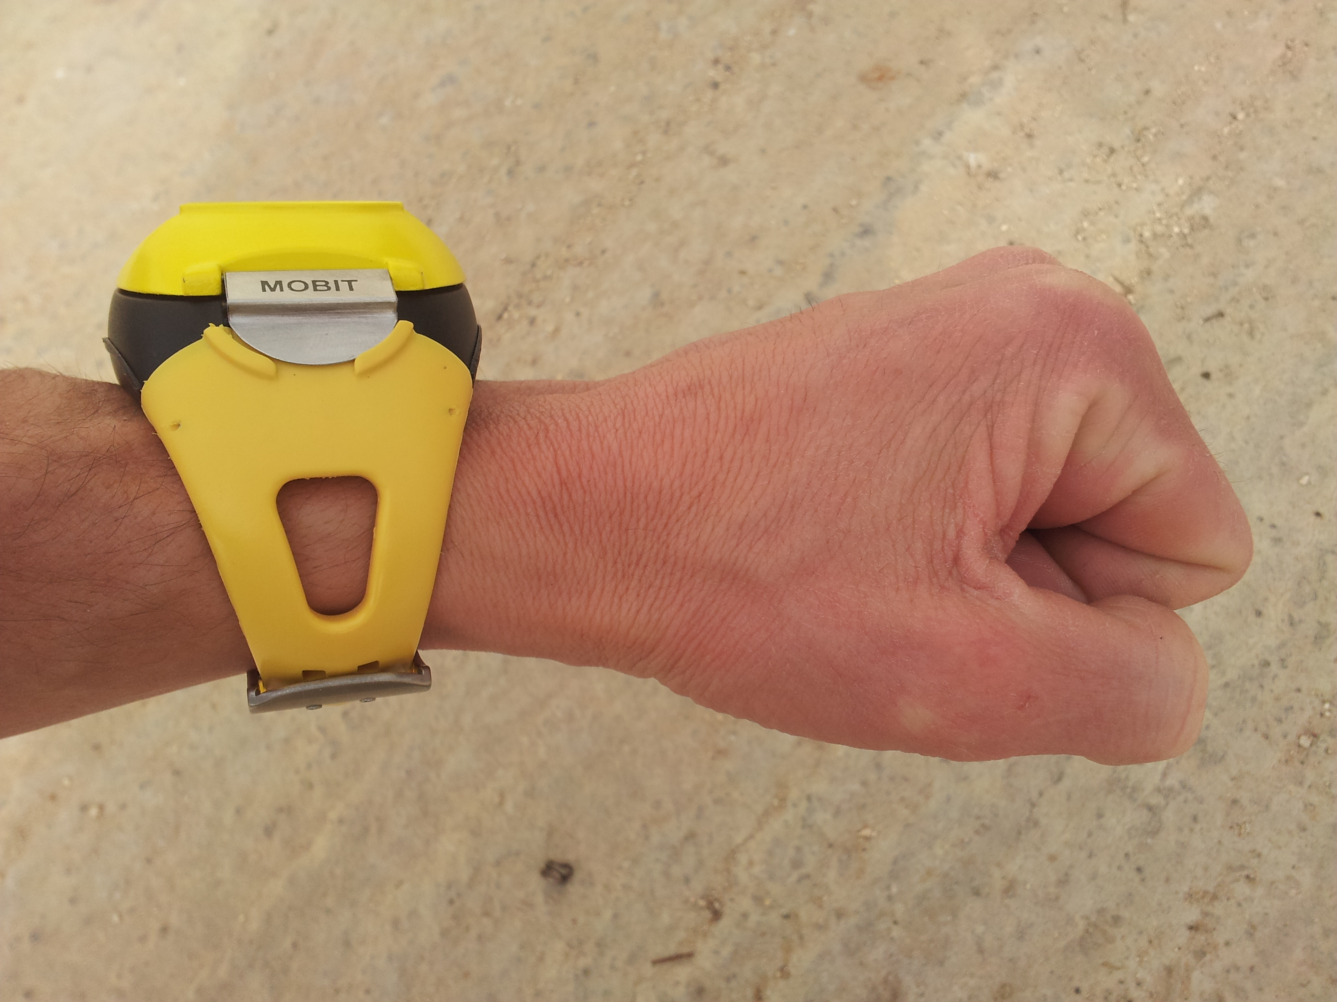

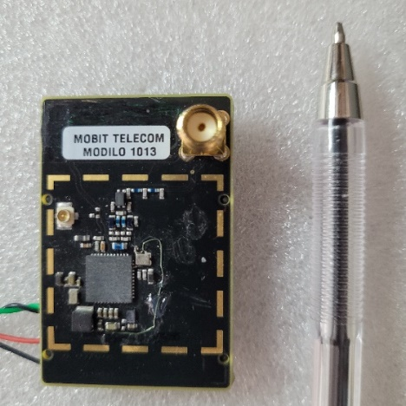
SINSIN Enabled Modules
SINSIN FGB (type approved)
SINSIN SGB chip
SINSIN MEOLUT
406 MHz receiver

Slide 11

Thank you for your attention !
Daniel Katz
Mobit Telecom
www.sat406.com

